Slide 1
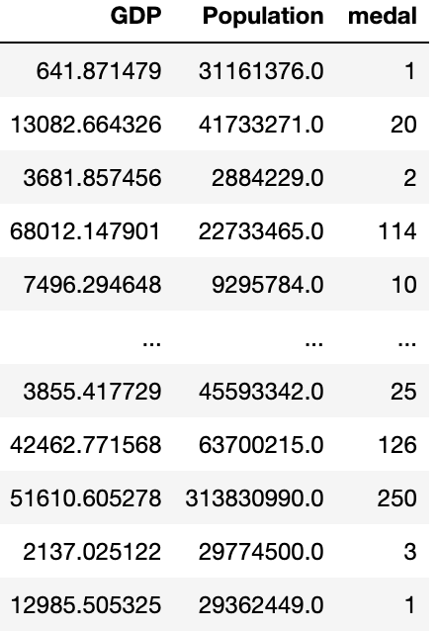
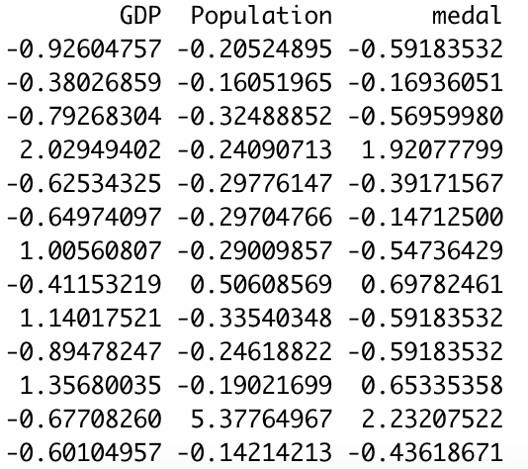

Making the data confess
（1）Purpose and processing of data
Purpose: Explore the impact of GDP and population on medals number
Data processing: Scale it. Each number in a group of numbers is subtracted from the average of the group of numbers and then divided by the root mean square of the group of numbers to eliminate the difference caused by different unit variables
after scale
raw data

Slide 2
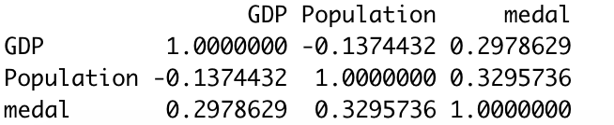
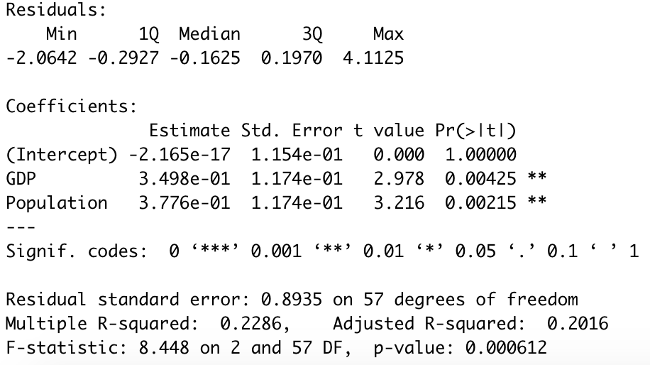
(2)linear correlation analysis between variables
cor
(3)Multiple linear regression model
lm1 model result:
P-value is good;
intercept is not significant;
GDP and Population are significant;
R-squared is small
lm1 result

Slide 3
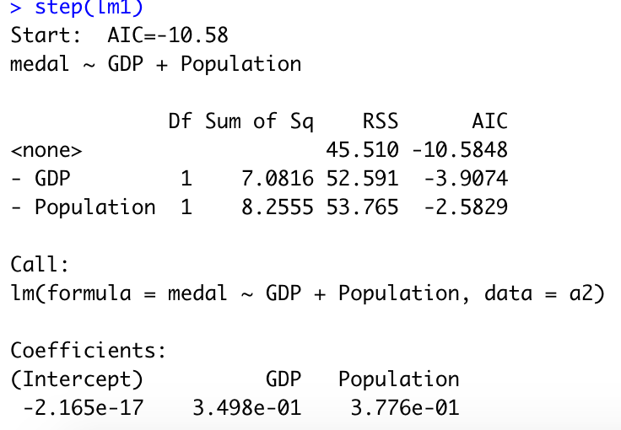
(4)variable selection
Using stepwise regression to select variables. The results also show that when GDP and Population exist at the same time, the AIC value of the model is the smallest, that is, the model at this time is the best. (The Akaike information criterion (AIC) is an estimator of prediction error and thereby relative quality of statistical models for a given set of data)
step regression

Slide 4
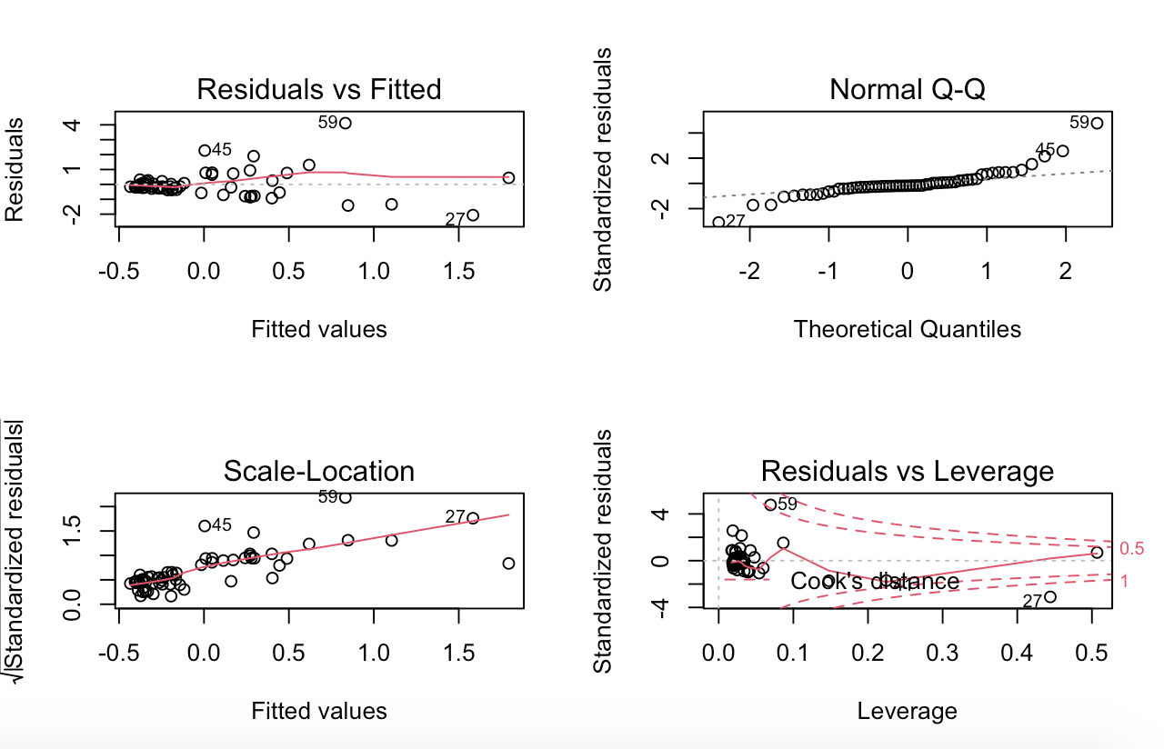
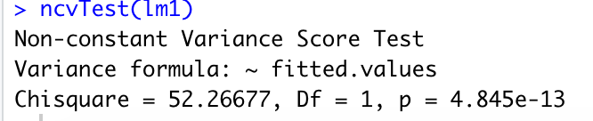
(5) Model checking
The scattered points in the upper left graph do not show any regularity, which means that there is a linear relationship. The scatter points in the upper right graph are roughly concentrated on the straight line in the QQ graph, indicating that the residuals are normal. The scatter points in the lower left graph may have rules, and the variance increases with the mean. The more the scatter points to the right, the larger the upper and lower spacing, and the more obvious the difference in variance. Check the abnormal points in the lower right picture, there may be abnormal points.
In order to make a more accurate diagnosis, we performed various tests with R. Such as: multicollinearity test, heteroscedasticity test, independence test, etc.
In these tests, We found that the model does not satisfy the assumption of homoscedasticity. In order to eliminate heteroscedasticity, we will change the model

Slide 5
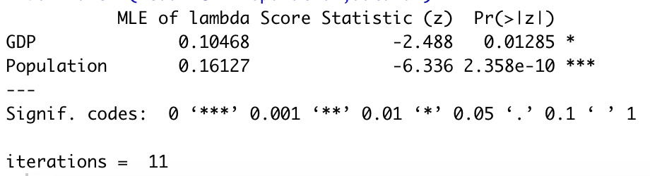
(6) Changing model
In this regard, we perform a power function on the variables in the model to eliminate heteroscedasticity, and use the car package to determine the power of GDP and Population
boxTidwell
The MLE of lambda is the best power of each variable
new model lm2

Slide 6
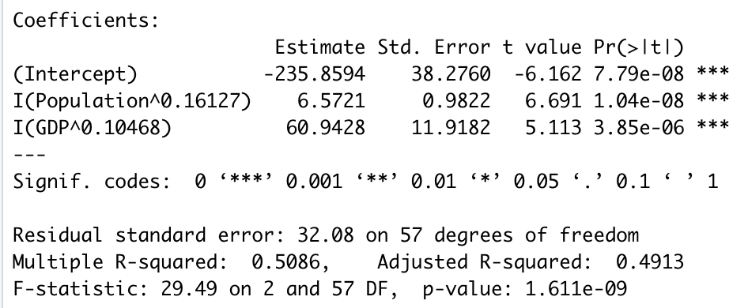
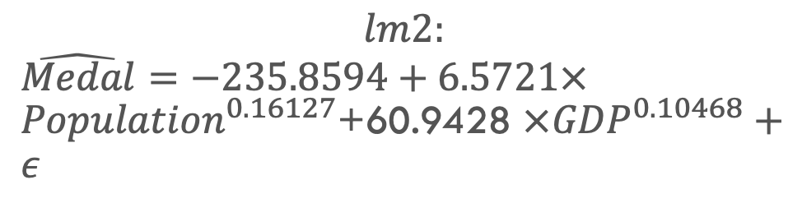
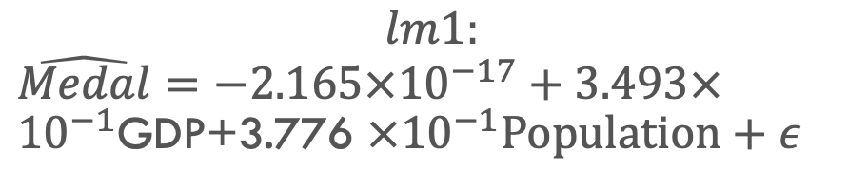
(6) models compare
$$lm1:$$
$\hat{Medal}=−2.165×{10}^{−17}+3.493×{10}^{−1}$GDP+3.776 $×{10}^{−1}Population+ε$
$$lm2:$$
$\hat{Medal}=−235.8594+6.5721×{Population}^{0.16127}$+60.9428 $×{GDP}^{0.10468}+ε$

